Slide 1

FPTU CAPSTONE PROJECT MANAGEMENT
Dec 31st, 2020

Slide 2
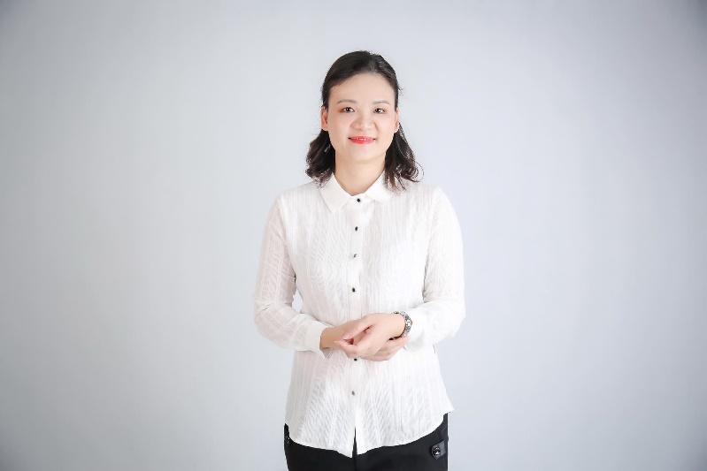
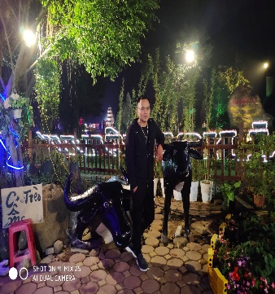
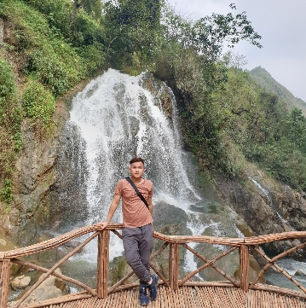
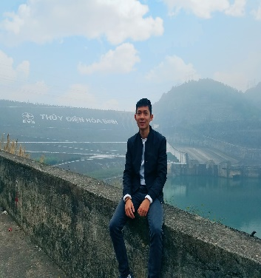

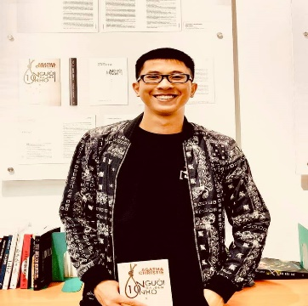
INTRODUCTION
Our Team
Do Dinh Duc
Bui Trung Kien
Nguyen Ngoc Khanh
Leader
Member
Member
Mrs. Nghiem Thi Lan Phuong
Supervisor
Nguyen Duc Long
Nguyen Minh Khang
Member
Member
Notes:
<a href='http://www.freepik.com/free-photo/close-up-of-happy-executive_856028.htm'>Designed by Freepik</a>
<a href='http://www.freepik.com/free-photo/smiling-young-businessman_856555.htm'>Designed by Freepik</a>
<a href='http://www.freepik.com/free-photo/team-of-friendly-businesspeople_858813.htm'>Designed by Freepik</a>
<a href='http://www.freepik.com/free-photo/close-up-of-successful-entrepreneur_867979.htm'>Designed by Freepik</a>

Slide 3
Table of Contents
CURRENT SITUATION & SOLUTION
PROJECT MANAGEMENT
SOFTWARE REQUIREMENTS
SPECIFICATION
ARCHITECTURE DESIGN
DATABASE TABLE DIAGRAM
DETAIL DESIGN
TEST PLAN ENVIRONMENT TEST
DEMO, Q&A

Slide 4
1.CURRENT SITUATION & SOLUTION

Slide 5
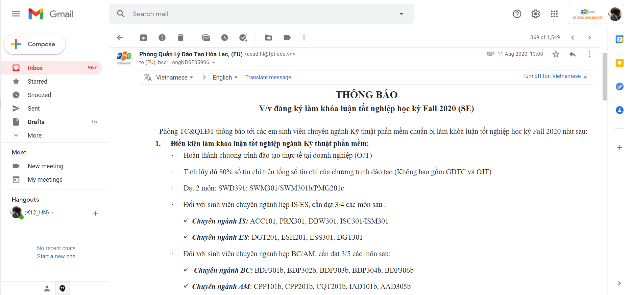
CURRENT SITUATION

Slide 6
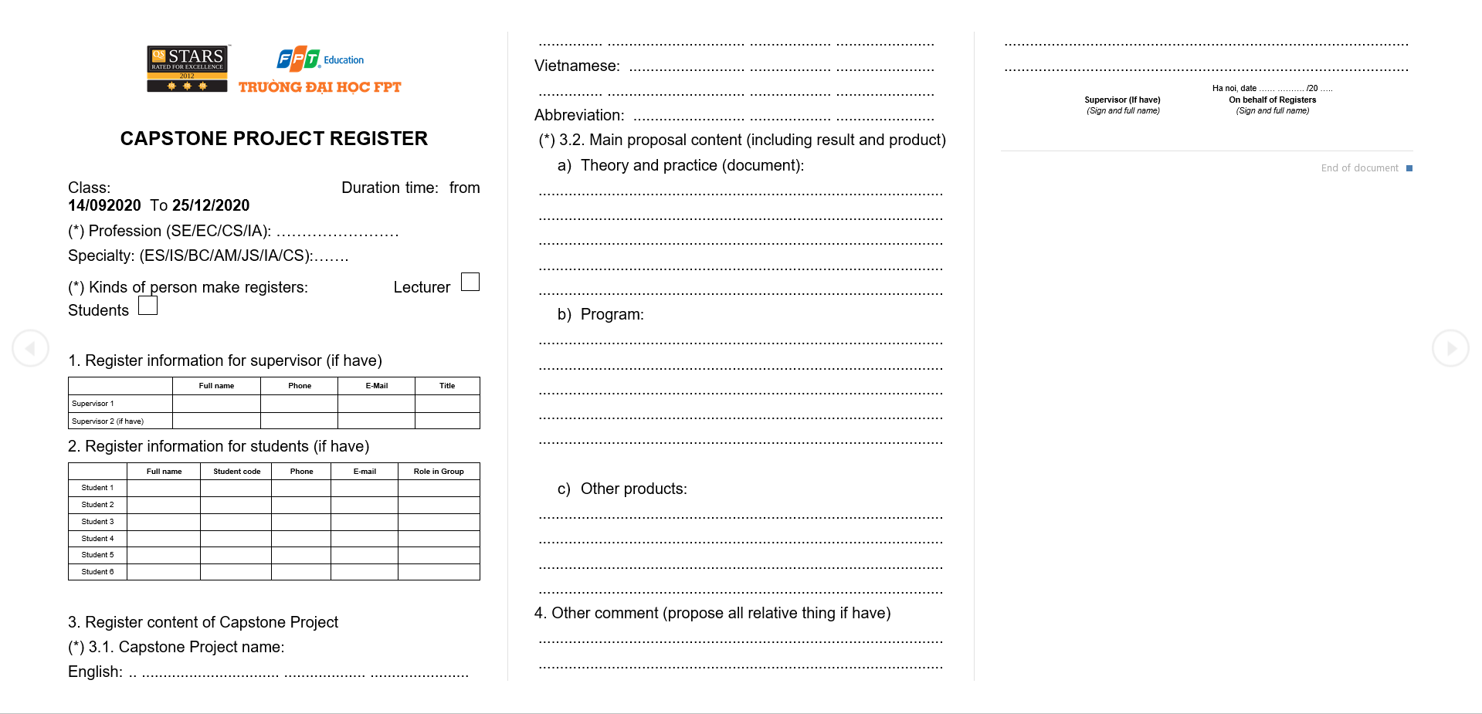
CURRENT SITUATION

Slide 7
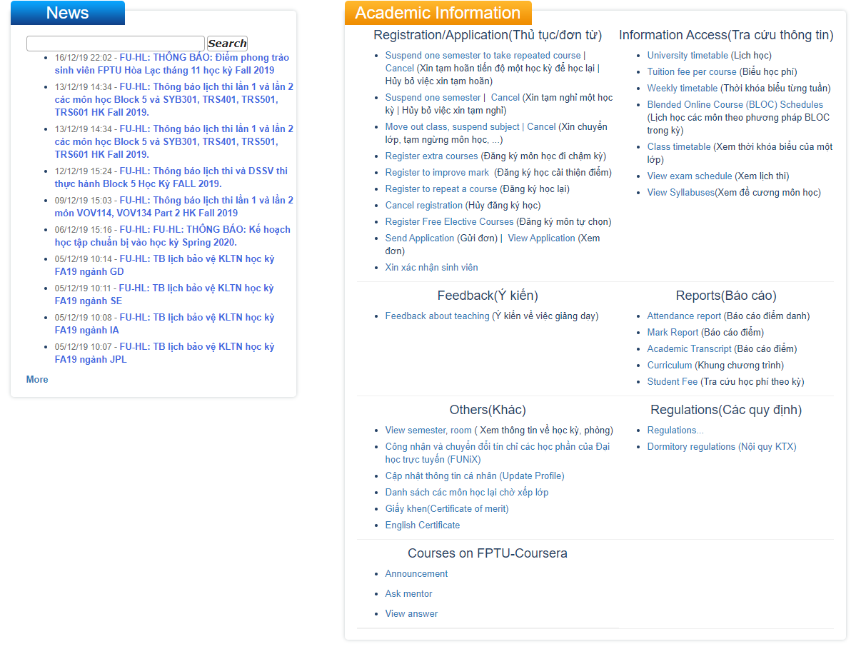
CURRENT SITUATION

Slide 8
SOLUTION
Proposal definition
System functions:
Allow the student.
Allow the student to login with FPT email accounts.
Allow the student to discuss and find teammates for capstone project in forum.
Allow the student to communicate via chat feature.
Allow the student to view and research project management models.
Allow the student to register projects.
Allow the student to view information and choose supervisors.
Allow the student to edit the capstone project’s name.
Allow the student to report the working process of the group.
Allow the student to report following Jira’s task template.
Allow the student to view news and notifications.

Slide 9
SOLUTION
System functions:
Allow supervisor to:
Allow the supervisor to login with FPT email accounts.
Allow the supervisor to discuss and gather team’s members for capstone project in forum.
Allow the supervisor to communicate via chat feature.
Allow the supervisor to view the list of registrants.
Allow the supervisor to confirm / reject the project.
Allow the supervisor to confirm / reject the request of changing project name.
Allow the supervisor to view the group’s working process.
Allow the supervisor to view and comment on reports

Slide 10
SOLUTION
System functions:
Allow the Training Department to:
Allow the training department to login with FPT email accounts.
Allow the training department to view capstone project in forum.
Allow the training department to communicate via chat feature.
Allow the training department to view the list of registrants.
Allow the training department to manage capstone projects.
Allows the training department to confirm / reject the request of changing project name.
Allow the training department to manage users.

Slide 11
SOLUTION
System functions:
Allow the Head of Department to:
Allow the head of department to login with FPT email account.
Allow the head of department to view capstone projects in forum.
Allow the head of department to communicate via chat feature.
Allow the head of department to confirm / reject the project.
Allow the head of department to view dashboard of all capstone projects.
Allow the head of department to view process of working in group.

Slide 12
SOLUTION
Out of scope functions:
FCPM adds functions for affairs department.
FCPM adds functions for examination council.
FCPM completes functions of assessing the process of project.
FCPM integrates API of project management systems.

Slide 13
2.PROJECT MANAGEMENT

Slide 14
TEAMWORK
Time : 8h / day , 7days / week
Location : Room D106, FPT University Hoa Lac
Communication : Phone , Email , Facebook , Zalo , Google meet , FCPM
Supervisor meeting : Once a week
Teambuilding : Once a month

Slide 15
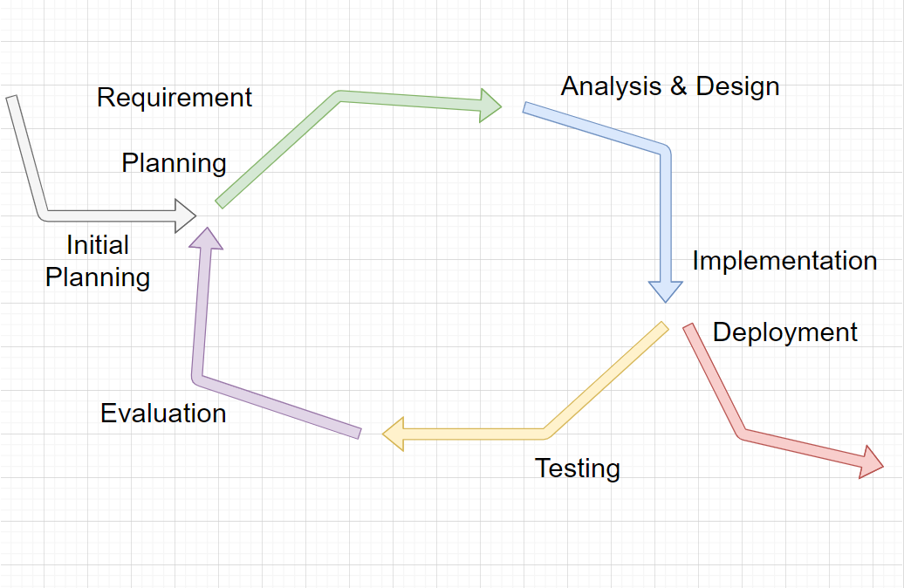
SOFTWARE PROCESS MODEL

Slide 16
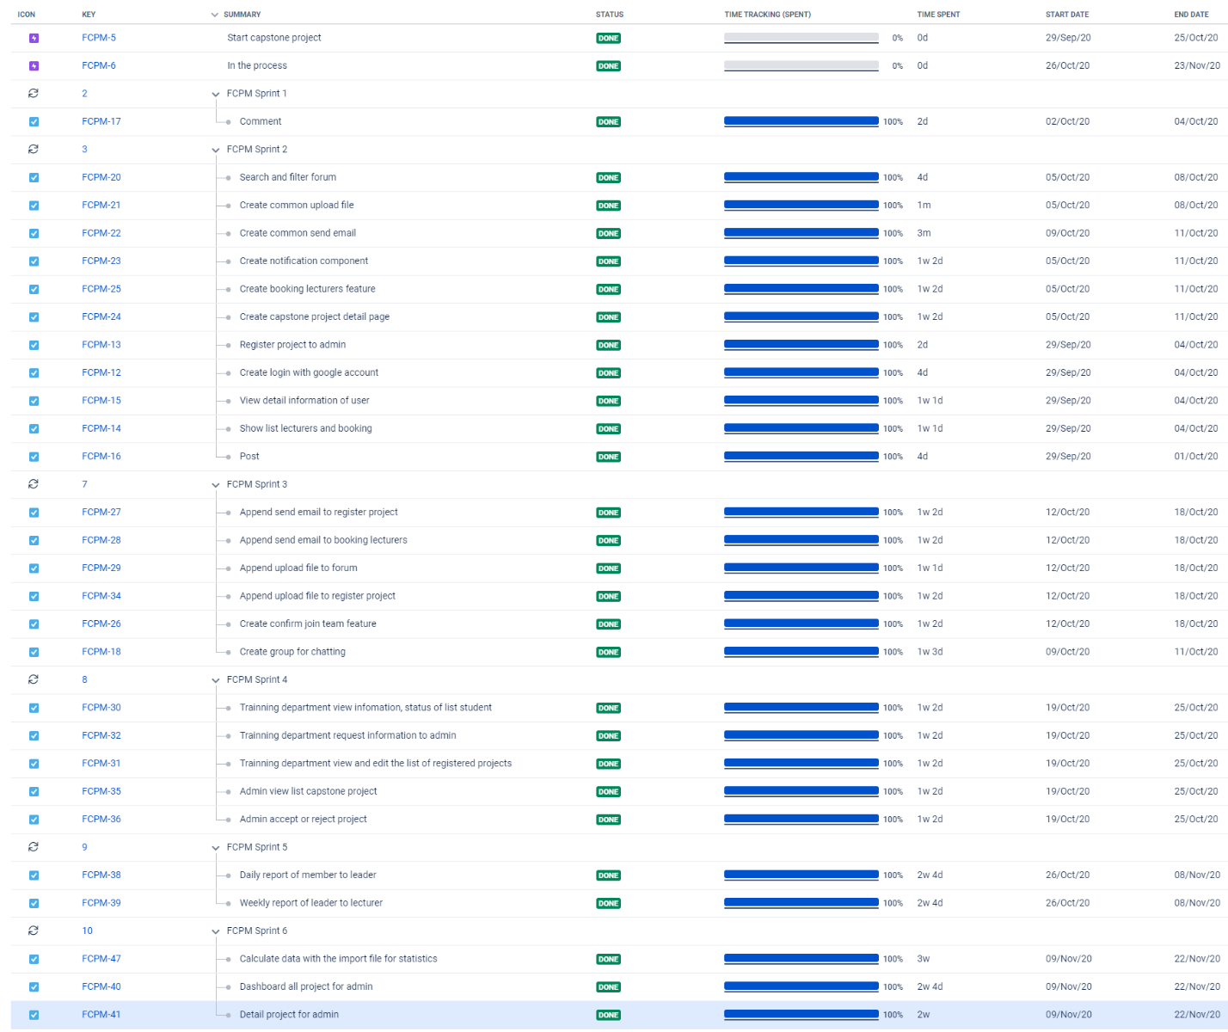
PROJECT MANAGEMENT PLAN

Slide 17
RISK MANAGEMENT
No | Description | Avoidance plan | Contingency plan | Status
R1 | Data loss | Using GitHub for version control. - Teaching members how to use Git and resolving conflicts. - Always have important backups. | - Restoring backed up data from GitHub. | Closed
R2 | Illness or absence of team members | - Providing schedules in advance. - For long periods of absence, members should notify the group in advance. | - Assigning the tasks of absent member to other members. - Working overtime if necessary. | Closed
R3 | Misunderstanding of Requirements | - Discussing requirements carefully with the customer. - Always ask for clarification if requirements are unclear. - Commenting needs to meet | -Making sure idea’s business logic is carefully analysed. | Closed
R4 | Changes in requirements | - Every new update of requirement has to be reviewed by all team members and supervisor. - Team member has to analyse requirements carefully before raising up to team. | - If requirement has new update, all members have to join the meeting to be aware and to make decisions. | Closed
R5 | Conflicts between team members | - Everything must be documented. - Every team member has to express clearly and carefully. | - Making sure any miscommunication has to be resolved. | Closed
R6 | Failed to meet deadline | - Planning and developing schedule carefully. - Assigning tasks carefully. - Defining punishment for team members who neglect work. | - Finding the root cause of the problem. - Reassigning tasks. - Focusing on important functions first. | Closed

Slide 18
PROJECT TOOLS
IntelliJ IDEA
MySQL Workbench
GitHub
Facebook, Zalo
Skype, Google Meet
Jira,Excel

Slide 19
3.SOFTWARE REQUIREMENTS SPECIFICATION

Slide 20
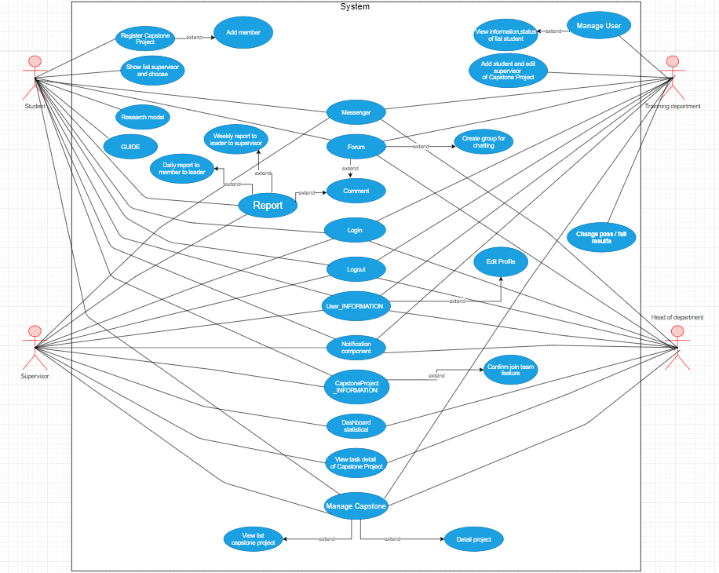
USE CASE DIAGRAM
4 Actor:
Student
Supervisor
Training department
Head of department

Slide 21
USER REQUIREMENT
MAIN FUNCTION:
Student System
Supervisor System
Training department System
Head of department System

Slide 22
SYSTEM REQUIREMENT
User Interface
Hardware Interface
Software Interface

Slide 23
NON-FUNCTIONAL REQUIREMENT
Security
Supportability
Accuracy
Maintainability and Extensibility
Usability
Performance

Slide 24
4.ARCHITECTURE DESIGN

Slide 25
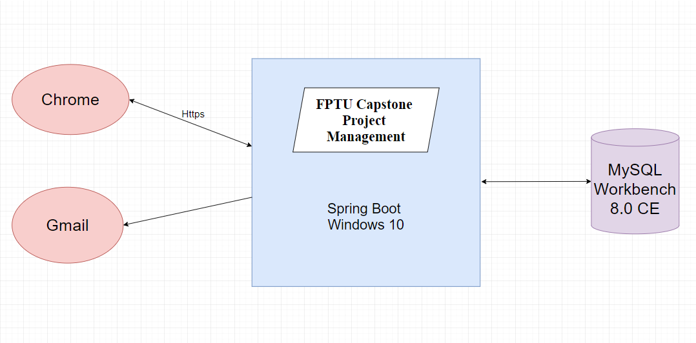
SYSTEM OVERVIEW

Slide 26
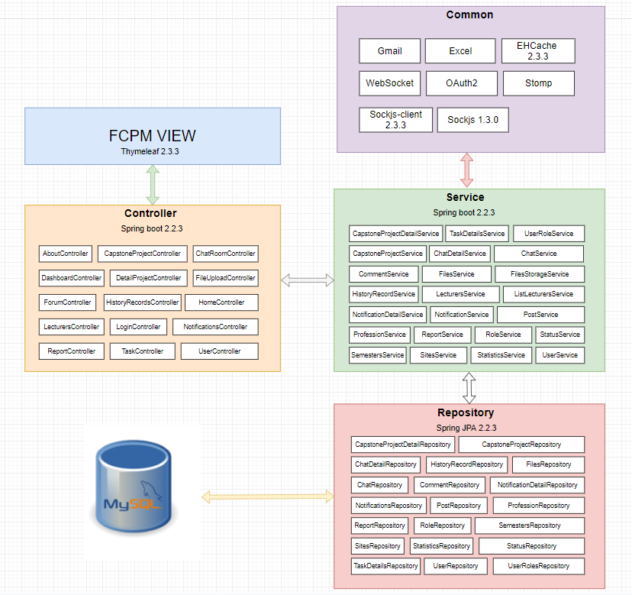
ARCHITECTURAL LAYERS DESIGN

Slide 27
5.DATABASE TABLE DIAGRAM

Slide 28
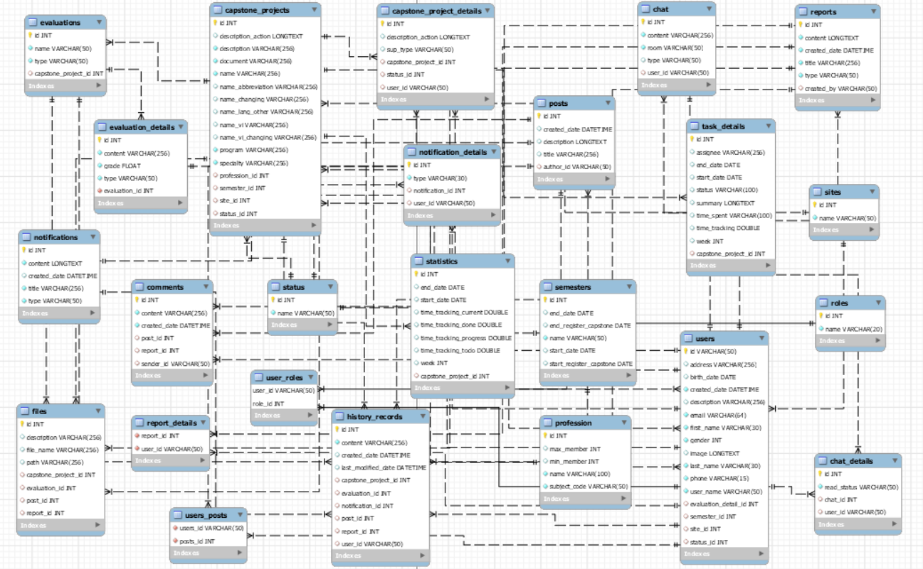
Database Diagram

Slide 29
6.DETAIL DESIGN

Slide 30
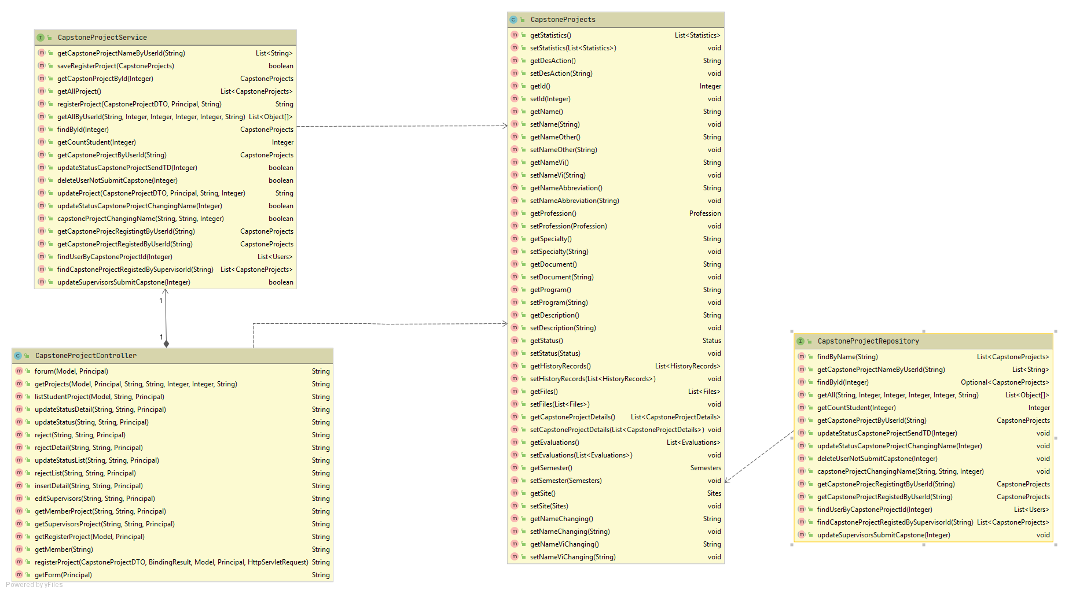
Class Diagram

Slide 31
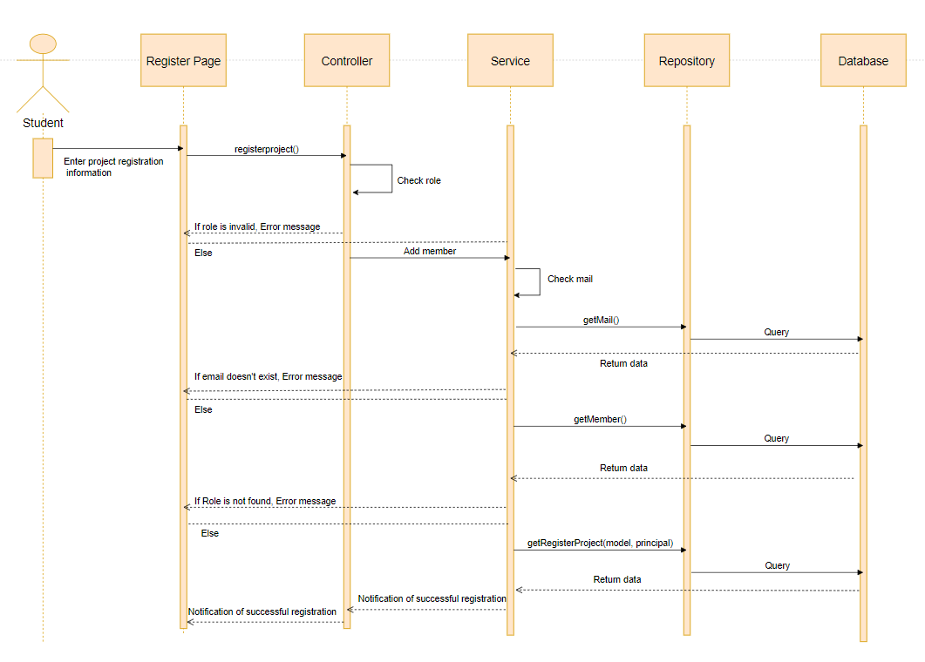
Sequence Diagram

Slide 32
7.TEST PLAN ENVIRONMENT TEST

Slide 33
INTRODUCTION
Scope of Testing
Test Plan
Test Strategy
Test Approach
Test Report

Slide 34





TESTING TOOLS
View the web page, bug logging page
Manage test cases
View app, bug login, etc..
View app, bug login, etc..
Manage bugs

Slide 35
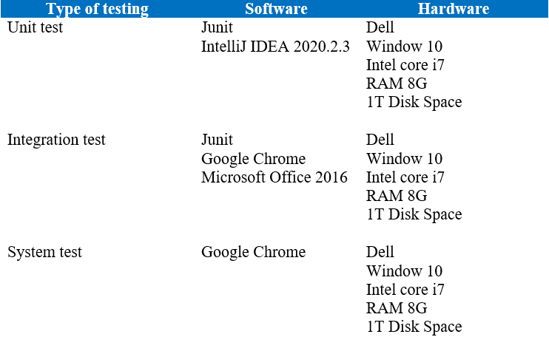
TESTING ENVIRONMENT

Slide 36
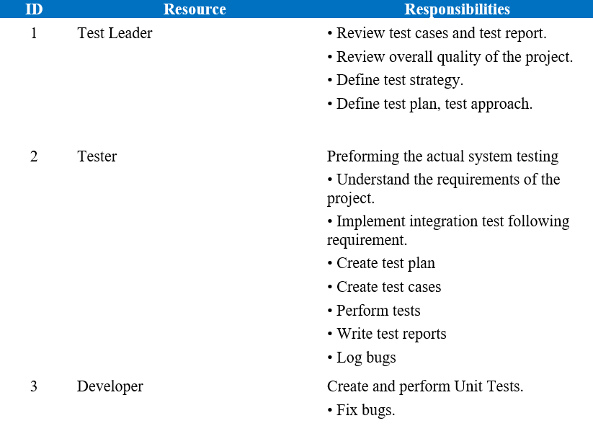
RESOURCES & RESPONSIBILITIES

Slide 37
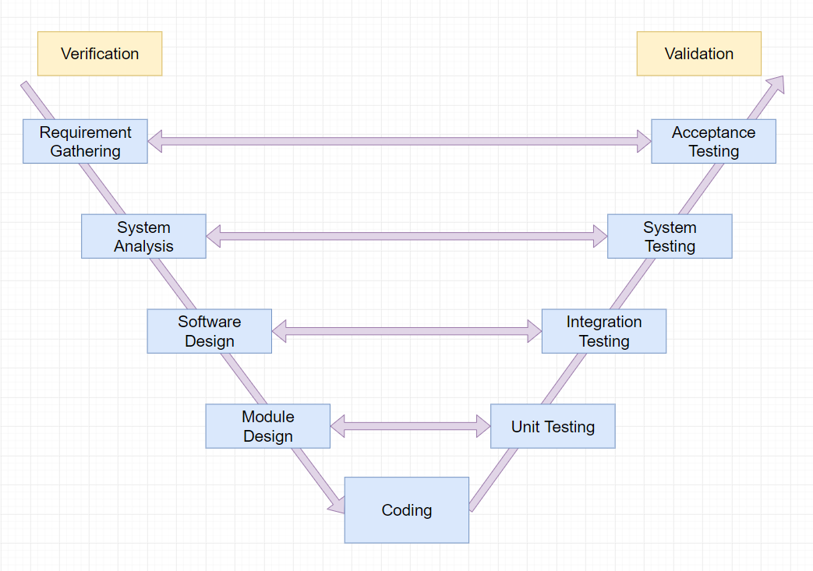
TEST MODEL

Slide 38
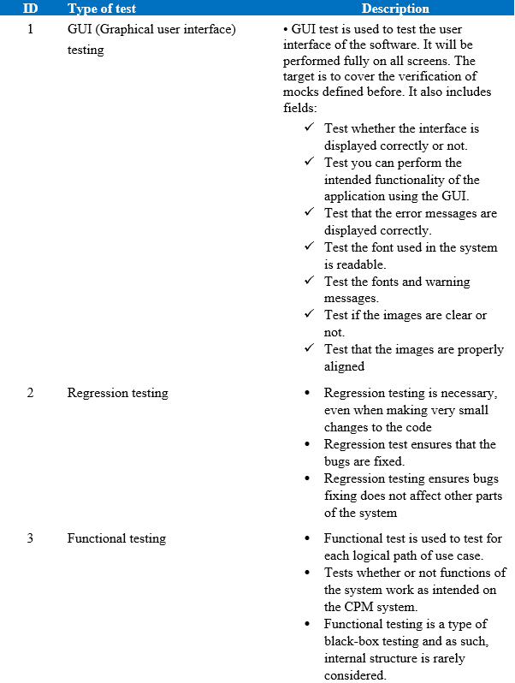
TYPE OF TESTING

Slide 39
TEST REPORT
No | Module code | Pass | Fail | Untested | N/A | Number of test cases
1 | Login | 7 | 0 | 0 | 0 | 7
2 | Forum | 38 | 0 | 0 | 0 | 38
3 | Register | 32 | 0 | 0 | 0 | 32
4 | Supervisors | 18 | 0 | 0 | 0 | 18
5 | List Report | 14 | 0 | 0 | 0 | 14
6 | Notification | 13 | 0 | 0 | 0 | 13
7 | Model | 47 | 0 | 0 | 0 | 47
8 | My Report | 14 | 0 | 0 | 0 | 14
9 | Create Report | 35 | 0 | 0 | 0 | 35
10 | Dashboard | 103 | 0 | 0 | 0 | 103
11 | User Information | 11 | 0 | 0 | 0 | 11
12 | Manage Capstone Project | 132 | 0 | 0 | 0 | 132
13 | My Capstone | 17 | 0 | 0 | 0 | 17
14 | Manage User | 57 | 0 | 0 | 0 | 57
15 | Header | 19 | 0 | 0 | 0 | 19
 | Sub total | 557 | 0 | 0 | 0 | 557
 | Test coverage |  | 100.00 | %
 | Test successful coverage |  | 100.00 | %

Slide 40
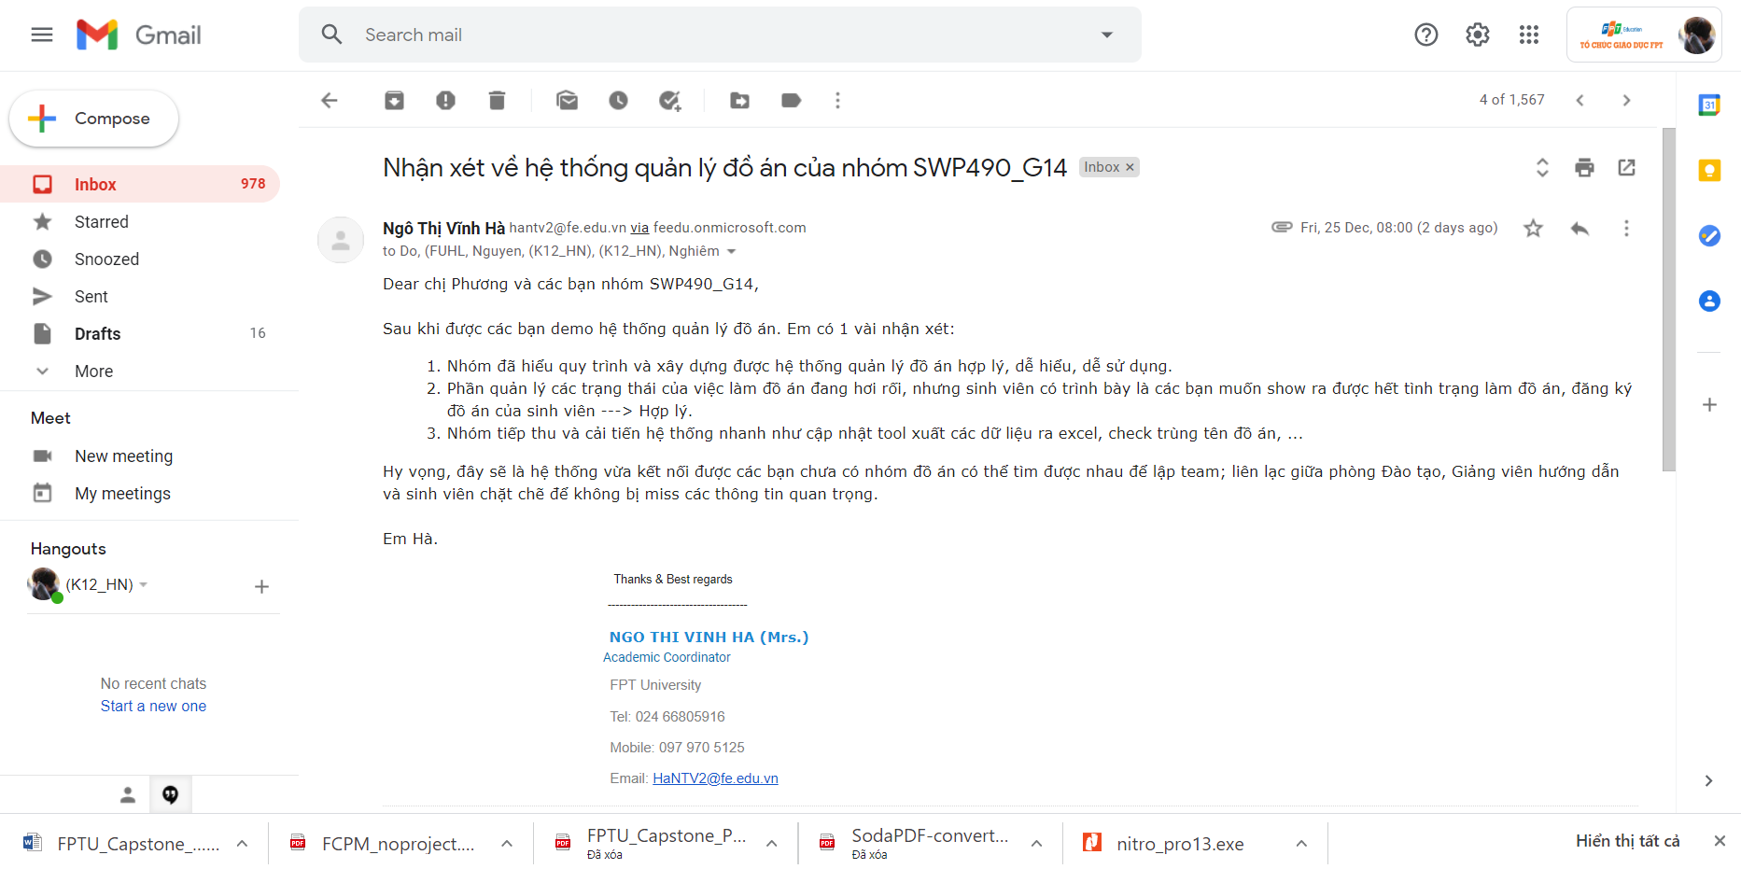
CUSTOMER’S FEEDBACK
Review of Ms. Ha in the training room:

Slide 41
8.DEMO, Q&A

Slide 42

THANKS FOR WATCHING !
Notes:
https://pixabay.com/en/new-york-city-tribute-in-lights-sky-78181/

